Slide 1


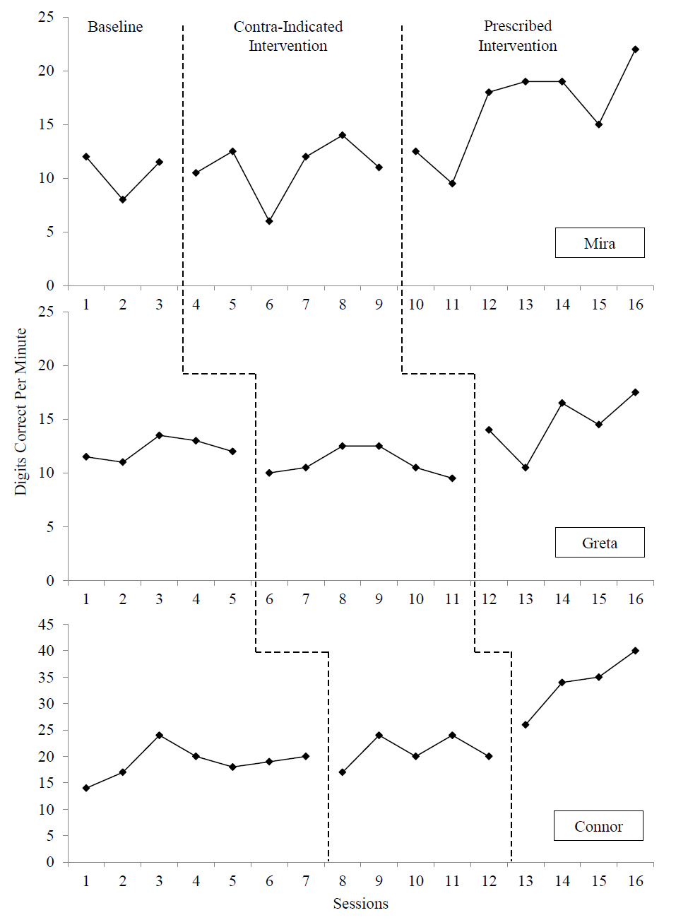
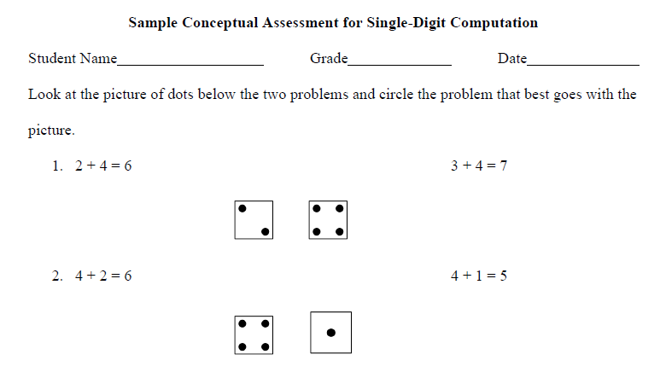
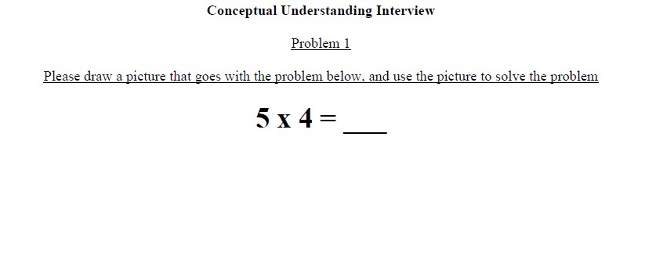
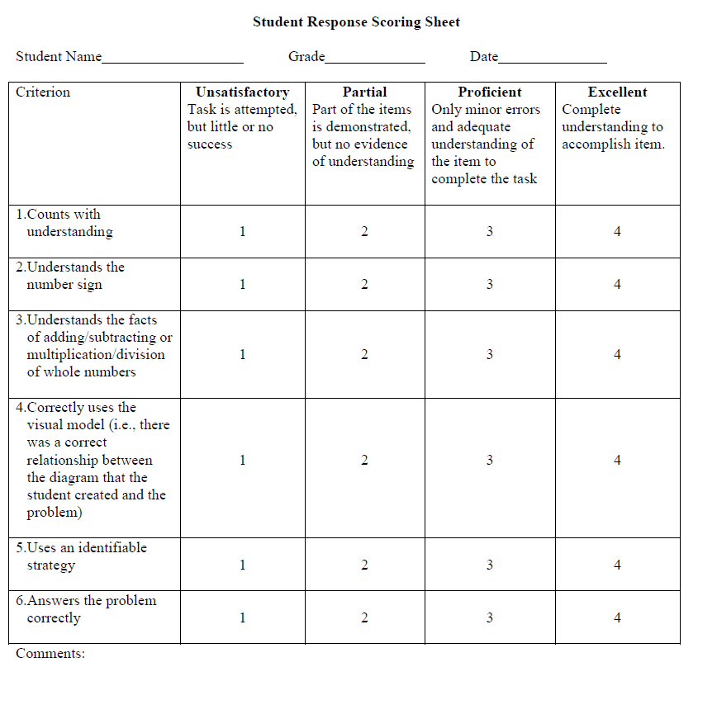
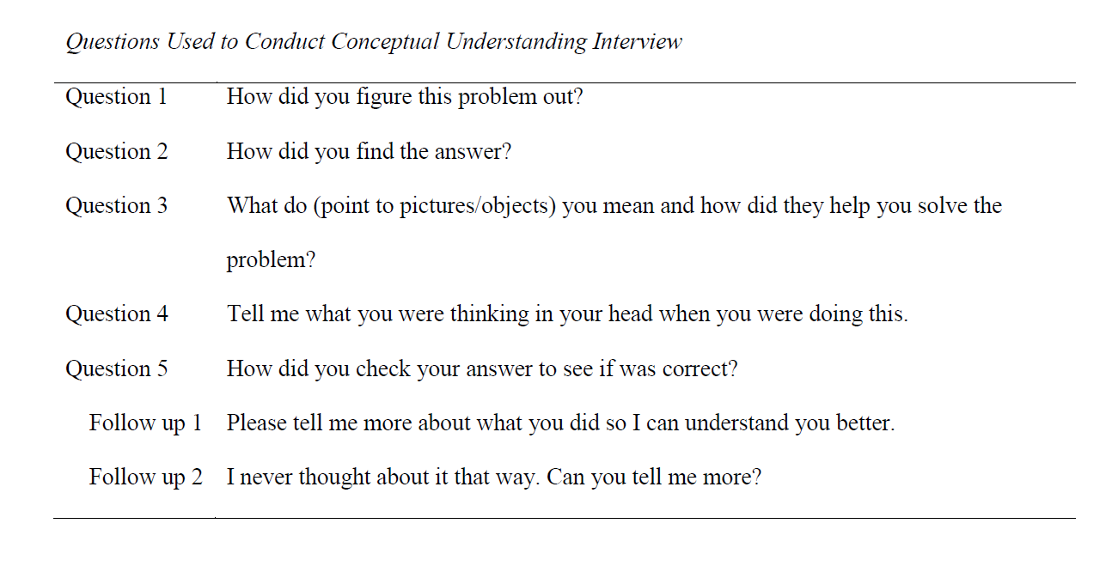
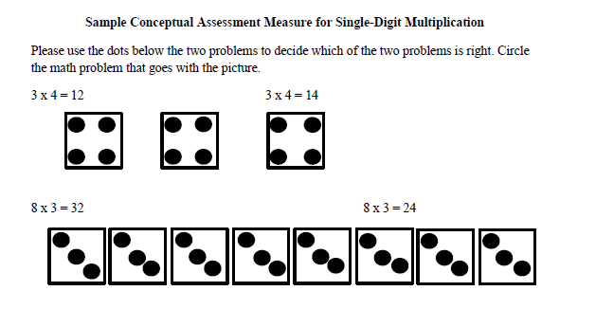

UNIVERSITY OF MINNESOTA
Instructional Utility of a Conceptual Understanding Assessment
for Students with Math Difficulties
Matthew K. Burns, Rebecca Kanive, Anne F. Zaslofsky, & Christopher Walick
College of Education + Human Development
Department of Educational Psychology
Introduction
  Math proficiency is comprised of both conceptual understanding and procedural fluency (NCTM, 2000; NMAP, 2008; NRC, 2001).
  Procedural fluency –
    Knowledge of rules, symbols, and sequence of steps required to complete math problems (Zamarian et al., 2007).
    Often assessed with fluency with basic facts as measured with curriculum-based measurement (CBM).
  Conceptual understanding –
    Recognizing and understanding the core underlying ideas of a subject such as the relationships and reasons that underlie the math problems in a certain area (Byrnes & Wasik, 1991; Hiebert & Lefevre, 1986).
    Meta-analytic research found a negligible effect for conceptual math interventions, which “present a complex puzzle of findings, open to multiple interpretations” (Baker, Gersten, & Lee, 2002, p. 66)
    Most conceptual understanding measures actually assess application (Zaslofsky & Burns, 2014).
    Conceptual understanding predicts math applications better than procedural knowledge for students who struggle with math (Kanive & Burns, 2014).
  Burns (2011) used conceptual and procedural knowledge as an intervention heuristic for math.
Purpose:
To develop a method of assessing conceptual understanding that is consistent with theory and improves student outcomes.
Method
Participants: Three students who scored below the 25th percentile on a math assessment. Mira – 1st grade White female; Greta – 1st grade White female; and Connor – 3rd grade White male. All three spoke English as their first language, had 95% school attendance or above for the year, and no reported behavior concerns.
Conceptual Interventions: Conceptual interventions were taken from Van Der Walle and Lovin (2005).
Modeling. Model problems with a white board, pennies and a circle.
Fill the Chutes. Use Connect Four ™ to fill columns with required number of pieces to represent the problem.
Build in Parts. Use a Mancala ™ board, to create problems with stones by placing a number in each cup.
Bowl a Fact. Used for addition only. Use a dry erase board with two sets of circles drawn on each side to represent bowling pins with numbers 2 through 15 written inside the circles. The interventionist and the student role dice and crossing out the number pin corresponding to the sum.
Broken Multiplication Key. Only used for multiplication. The student is allowed to use a calculator to solve multiplication problems, but the multiplication key is disabled.
Procedural Intervention. Incremental Rehearsal (IR; Tucker, 1988) for math facts was used to increase procedural fluency. Previous research found a large effect (φ = .94) for practicing math facts with IR (Burns et al., 2012).
Procedure. Students were screened with four single-digit addition (first-grade) or multiplication (third-grade) CBM and conceptual understanding probes.
All three students scored below criteria for CBM probes.
Mira and Connor both answered all 10 problems correctly on all four conceptual assessments. They demonstrated difficulties with procedural fluency, but displayed acceptable conceptual understanding.
Greta averaged 57.5% (SD = 17.1%) correct on the four conceptual assessments of addition. She demonstrated a difficulty with conceptual understanding.
Contra-indicated = conceptual for Mira and Connor, and procedural for Greta.
Prescribed intervention = procedural for Mira and Connor, and conceptual for Greta.
Interventions occurred 4 days a week for 20 minutes each, and were one-on-one.
Interventions started with the contra-indicated intervention for 2 weeks and then changed to the prescribed one.
Table 1
Descriptive Statistics for Digits Correct Per Minute During Baseline and Interventions
 | Baseline |  |  | Contra-Indicated |  |  | Prescribed
Name | M | SD | Slope | M | SD | Slope | M | SD | Slope | PND†
Mira | 7.88 | 2.18 | -1.75 | 11.00 | 2.74 | 2.60 | 16.43 | 4.32 | 10.13 | 71.4%
Greta | 12.20 | 1.04 | 2.10 | 10.92 | 1.28 | -0.50 | 14.60 | 2.70 | 7.70 | 80%
Connor | 18.86 | 3.08 | 0.57 | 21.00 | 3.00 | 0.60 | 33.75 | 5.80 | 4.30 | 100%
MEASURES
†Percentage of Nonoverlapping data as compared to contra-indicated intervention.
Note. Slope is digits correct per minute per week.
Discussion
  Neither intervention was effective unless it was the prescribed intervention.
    PND for contra-indicated intervention = 11.76% as compared to baseline
    PND for prescribed intervention = 81.25% as compared to the contra-indication phase.
    PND for the conceptual intervention = 37.5% as compared to the preceding phase.
    PND for procedural intervention = 52.9% as compared to the preceding phase.
  Mean DCPM scores during the prescribed intervention phase exceeded criterion for procedural fluency (Burns et al., 2006).
  Limitations
  The study did not take into account the quality or focus of core instruction.
  The focus of the study was on early math skills with few implications for older students.
  The first-grade students targeted addition, which was a different target than for the third-grade student. Future researchers should consider intervening with students from one grade.
  More psychometric research is needed regarding the conceptual understanding assessment.
School Psychology
250 Education Sciences Building
56 E. River Road, Minneapolis, MN 55455
Contact - Matthew Burns: burns258@umn.edu

